Slide 1
PKE/KEM constructions
Broadly LWE-like
  Product LWE
    Main Variant (Frodo, Kyber, Saber, Three-Bears, LAC, NewHope, Round5, NTRU-LPRime, HQC, RQC)
    Ouroboros variant (BIKE-3, ROLLO-III)
  Quotient LWE (NTRU, sNTRUprime, BIKE-1,2 ,LEDAcrypt, ROLLO-1,2)
Other
  Goppa codes (Classic McEliece, NTS-KEM)
  Isogenies (SIKE)

Slide 2
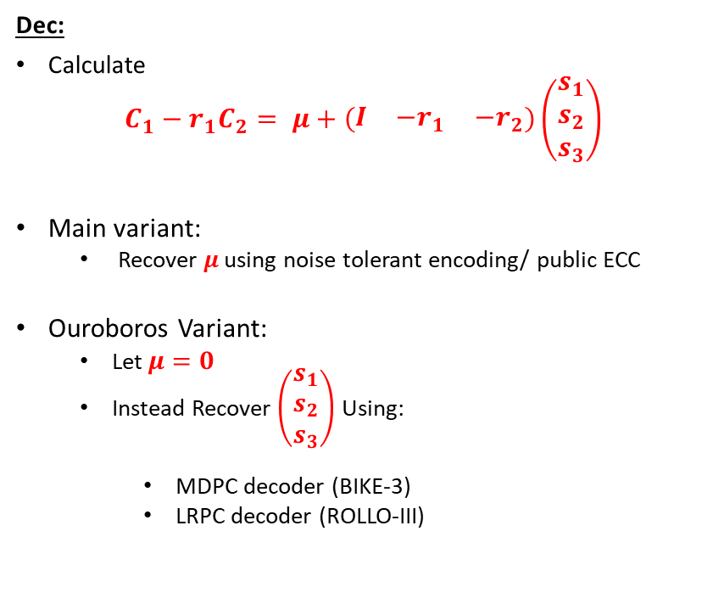
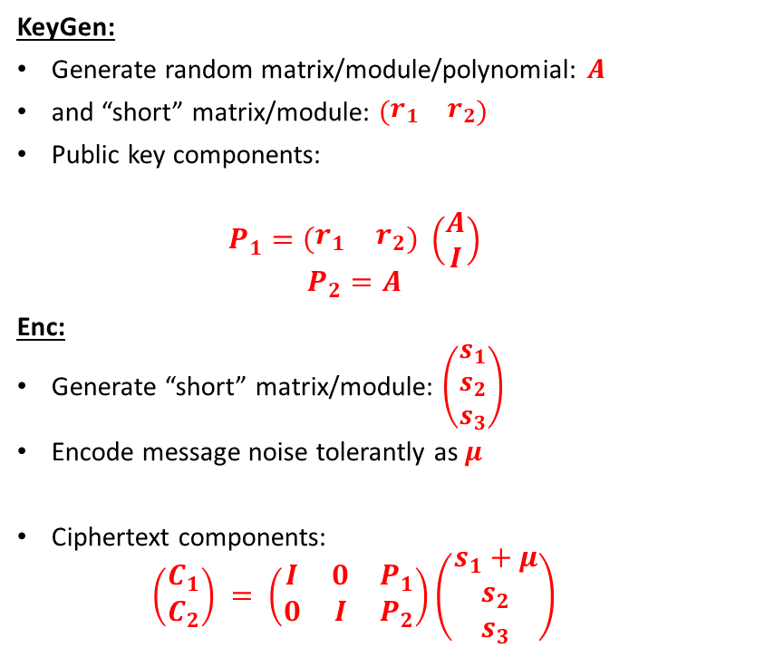
Product LWE
KeyGen:
Generate random matrix/module/polynomial: $A$
and “short” matrix/module: $\left(\begin{matrix}r_{1} & r_{2}\end{matrix}\right)$
Public key components:
  $$P_{1}=\left(\begin{matrix}r_{1} & r_{2}\end{matrix}\right) \left(\begin{matrix}A \\ I\end{matrix}\right)$$
  $$P_{2}=A$$
Enc:
Generate “short” matrix/module: $\left(\begin{matrix}s_{1} \\ s_{2} \\ s_{3}\end{matrix}\right)$
Encode message noise tolerantly as $μ$
Ciphertext components:
  $$\left(\begin{matrix}C_{1} \\ C_{2}\end{matrix}\right) = \left(\begin{matrix}I & 0 & P_{1} \\ 0 & I & P_{2}\end{matrix}\right)\left(\begin{matrix}s_{1}+μ \\ s_{2} \\ s_{3}\end{matrix}\right)$$
Dec:
Calculate
$$C_{1}−r_{1}C_{2}= μ+\left(\begin{matrix}I & {−r}_{1} & {−r}_{2}\end{matrix}\right)\left(\begin{matrix}s_{1} \\ s_{2} \\ s_{3}\end{matrix}\right)$$
Main variant:
  Recover $μ$ using noise tolerant encoding/ public ECC
Ouroboros Variant:
  Let $μ=0$
  Instead Recover $\left(\begin{matrix}s_{1} \\ s_{2} \\ s_{3}\end{matrix}\right)$ Using:
    MDPC decoder (BIKE-3)
    LRPC decoder (ROLLO-III)

Slide 3
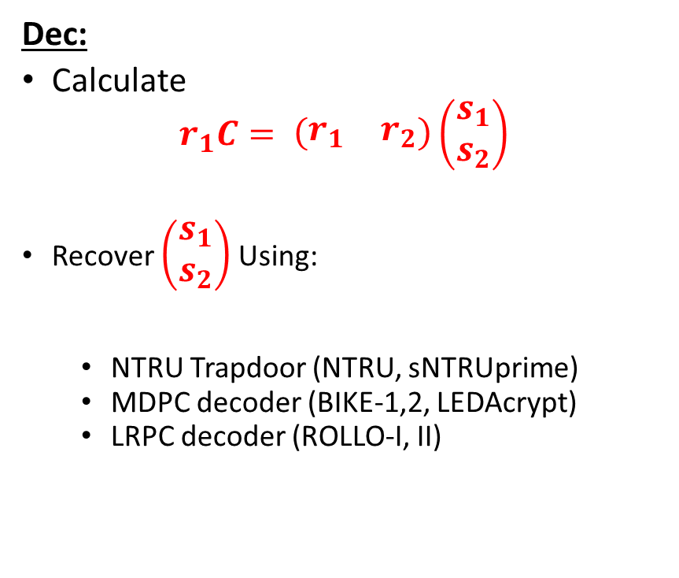
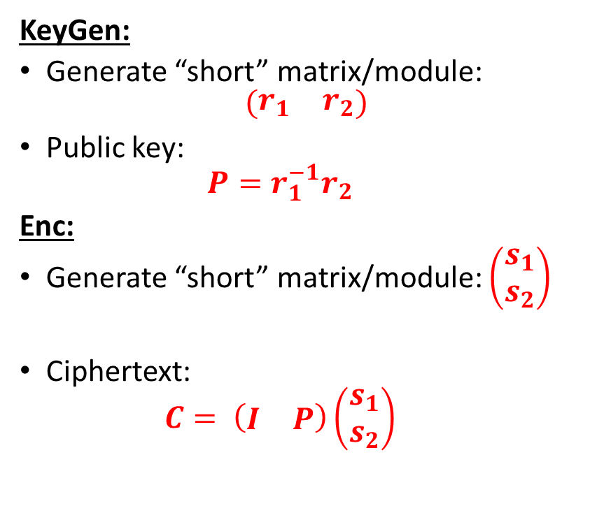
Quotient LWE
KeyGen:
Generate “short” matrix/module:
$$\left(\begin{matrix}r_{1} & r_{2}\end{matrix}\right)$$
Public key:
  $$P=r_{1}^{−1}r_{2}$$
Enc:
Generate “short” matrix/module: $\left(\begin{matrix}s_{1} \\ s_{2}\end{matrix}\right)$
Ciphertext:
  $$C= \left(\begin{matrix}I & P\end{matrix}\right)\left(\begin{matrix}s_{1} \\ s_{2}\end{matrix}\right)$$
Dec:
Calculate
$$r_{1}C= \left(\begin{matrix}r_{1} & r_{2}\end{matrix}\right)\left(\begin{matrix}s_{1} \\ s_{2}\end{matrix}\right)$$
Recover $\left(\begin{matrix}s_{1} \\ s_{2}\end{matrix}\right)$ Using:
  NTRU Trapdoor (NTRU, sNTRUprime)
  MDPC decoder (BIKE-1,2, LEDAcrypt)
  LRPC decoder (ROLLO-I, II)

Slide 4
Design Choices for Product/Quotient LWE
Metric:
  Euclidean (Frodo, Kyber, Saber, ThreeBears, LAC, NewHope, Round5, NTRU, NTRU-Prime)
    Characteristic attack: Lattice reduction (LLL, BKZ, Sieving, Enumeration)
  Hamming (BIKE, HQC, LEDAcrypt)
    Characteristic attack: Information set decoding
  Rank (RQC, ROLLO)
    Characteristic attacks:
      Combinatorial: Linear algebra search /support trapping
      Algebraic (Minors, Kipnis-Shamir, Syndrome modeling)

Slide 5
Noise Distribution
Fixed Weight (NTRU, sNTRUprime, BIKE, HQC, ROLLO, RQC)
  Seems to protect against failure boosting attacks. How effectively?
  For lattices, security proofs generally assume Gaussian noise. Is this distribution different enough to lead to problems?
Fixed Weight/Product structure (LEDAcrypt)
  The product structure enables an attack!
Binomial (Frodo, Kyber, LAC, NewHope, ThreeBears)
  Closer to Gaussian. Close enough?
  Subject to failure boosting
Rounding (NTRU-LPRime, Round5, Saber)
  No known reduction from LWE to LWR, but no known attacks on normal parameter ranges for LWR KEMs.
  Subject to failure boosting

Slide 6
Ring/module structure
  None (Frodo, Round5N1)
    Larger PKE/CT for product LWE. Much larger public key for quotient (No submissions)
  Ring (LAC, NewHope, Round5Nd, NTRU, NTRUprime, BIKE, HQC, LEDAcrypt, ROLLO, RQC)
    Needed to optimize bandwidth for Quotient LWE schemes, as well as Hamming and Rank Schemes
  Module (Kyber, Saber, ThreeBears)
    For lattice product LWE, there is essentially no performance penalty for choosing module over ring
    Is there security benefit to less structured lattice?

Slide 7
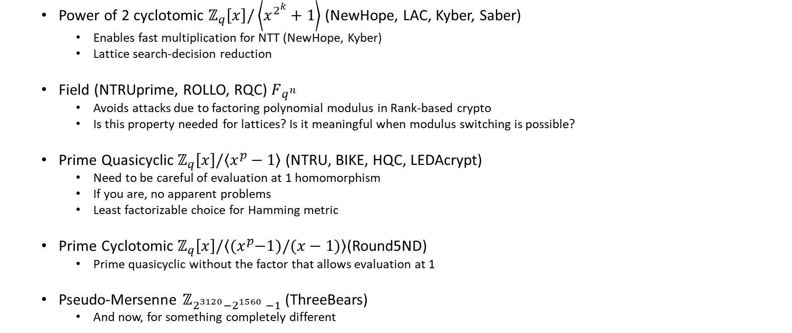
Which ring is the one ring to rule them all?
  Power of 2 cyclotomic $ℤ_{q}\left[x\right]/\left\langle x^{2^{k}}+1\right\rangle$ (NewHope, LAC, Kyber, Saber)
    Enables fast multiplication for NTT (NewHope, Kyber)
    Lattice search-decision reduction
  Field (NTRUprime, ROLLO, RQC) $F_{q^{n}}$
    Avoids attacks due to factoring polynomial modulus in Rank-based crypto
    Is this property needed for lattices? Is it meaningful when modulus switching is possible?
  Prime Quasicyclic $ℤ_{q}\left[x\right]/\left\langle x^{p}−1\right\rangle$ (NTRU, BIKE, HQC, LEDAcrypt)
    Need to be careful of evaluation at 1 homomorphism
    If you are, no apparent problems
    Least factorizable choice for Hamming metric
  Prime Cyclotomic $ℤ_{q}\left[x\right]/\left\langle {(x}^{p}−1)/(x−1)\right\rangle$(Round5ND)
    Prime quasicyclic without the factor that allows evaluation at 1
  Pseudo-Mersenne $ℤ_{2^{3120}−2^{1560} −1}$ (ThreeBears)
    And now, for something completely different

Slide 8
Decoding
(Principally relevant for cost of side channel resistance)
Regev or NTRU style rounding only (Frodo, Kyber, Saber, NTRU, NTRUPrime)
Repetition/Majority (NewHope)
XE5 (Round5)
Melas FEC (ThreeBears)
BCH (LAC, HQC)
Gabidulin (RQC)
LRPC decoder (ROLLO)
BitFlipping (BIKE, LEDAcrypt)

